Slide 1


Basics of Statistics
Archer Infotech , PUNE
www.archerinfotech.in

Slide 2
What is Dataset ?
A data set contains information's about a sample. A Dataset consists of cases. Cases are nothing but the objects in the collection. Each case has one or more attributes or qualities, called variables which are characteristics of cases.
Suppose you are collecting information about breast cancer patients. Now for each and every cancer patient you want to know the below information
1. Sample code number: id number
2. Clump Thickness: 1 – 10
3. Uniformity of Cell Size: 1 – 10
4. Uniformity of Cell Shape: 1 – 10
5. Marginal Adhesion: 1 – 10
6. Single Epithelial Cell Size: 1 – 10
7. Bare Nuclei: 1 – 10
8. Bland Chromatin: 1 – 10
9. Normal Nucleoli: 1 – 10
10. Mitoses: 1 – 10
11. Class: (2 for benign, 4 for malignant)
For this example, breast cancer patients themselves are cases and all these characteristics of the patients are variables.

Slide 3
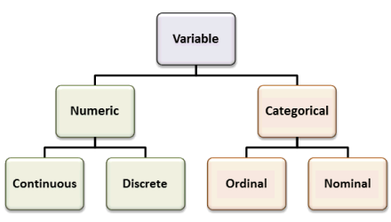
Types of Variables

Slide 4
Categorical Variables
Both nominal and ordinal variables can be called categorical variables.
Nominal Variable:
A nominal variable is made up of various categories which has no order.
Example:
Gender of a patient may be Male or Female or State where they live in. Here each category differs from each other but there is no ranking order.
2. Ordinal Variable:
The second level of measurement is the ordinal level. There is not only a difference between the categories of a variable; there is also an order.
An example might be Highest paid, Average Paid and Lowest Paid employee.

Slide 5
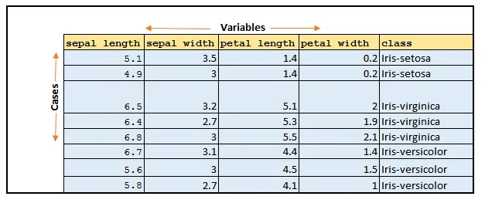
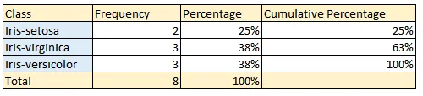
Data Matrix and Frequency Table

Slide 6
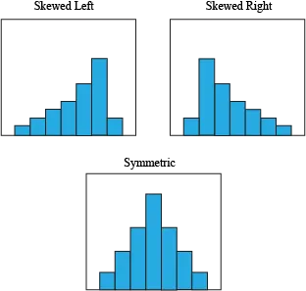
Histograms
A histogram is similar to a bar graph in the sense that it uses bars to portray the frequencies or relative frequencies of the possible values of a variable. However, there is one important difference. That difference is that the bars in a histogram touch each other. This touching represents that the values of an interval/ratio variable represent an underlying continuous scale

Slide 7
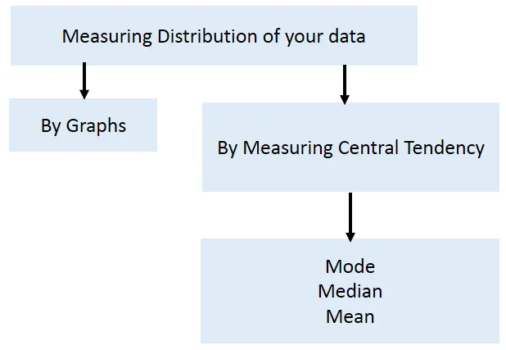
Mode , Median , Mean

Slide 8
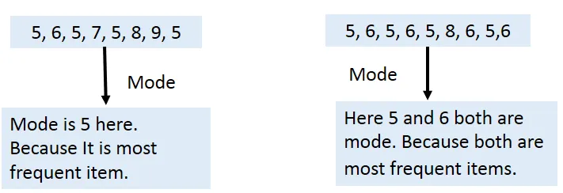
Mode
If your variable of interest is measured in nominal or ordinal (Categorical) level then Mode is the most often used technique to measure the central tendency of your data.
Finding the mode is easy. Basically, it is the value that occurs most frequently. In other words, mode is the most common outcome. Mode is the name of the category that occurs more often.
There is a chance of having more than one mode in your variable.

Slide 9
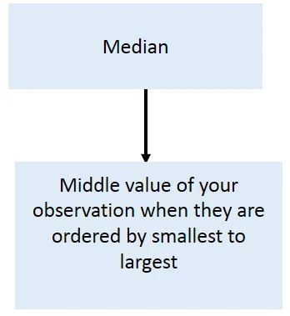
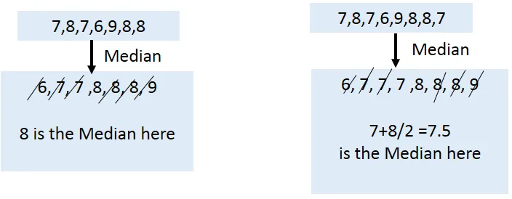
Median
The second measure of central tendency is the median. The median is nothing more than the middle value of your observations when they are order from the smallest to the largest.

Slide 10

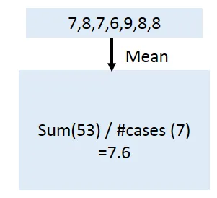
Mean
The mean is the sum of all the values divided by the number of observations. It is nothing but the average value.

Slide 11
Mean , Median , Mode which to use ?
If data is Categorical (Nominal or Ordinal) it is impossible to calculate mean or median. So, go for mode.
If your data is quantitative then go for mean or median. Basically, if your data is having some influential outliers or data is highly skewed then median is the best measurement for finding central tendency. Otherwise go for Mean.

Slide 12
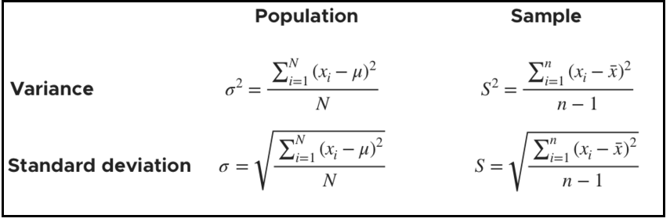
Variance and Standard Deviation
If variance is high, that means you have larger variability in your dataset. In the other way, we can say more values are spread out around your mean value.
Standard deviation represents the average distance of an observation from the mean
The larger the standard deviation, larger the variability of the data.

Slide 13

Z Score
A Standardized Score (Z-Score) is useful to know how many standard deviations an element falls from the mean.
A z-score can be calculated from the following formula.
Z-score will help to understand a specific observation is common or exceptional in your study.

Slide 14
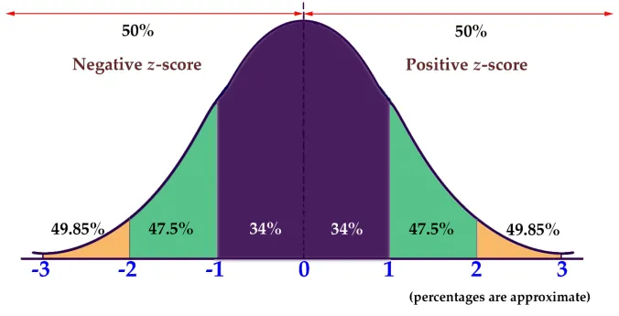
Why Z Score Needed ?
Sometimes, in your statistical analysis you want to figure out a specific observation is common or exceptional case. Then Z-score will help to understand the standard deviation it falls below or above the mean

Slide 15
THANK YOU !!!
Amol Patil - 9822291613

